Slide 1

ProCare Application
Francisco Javier Muñoz Ruiz
José Ignacio Daguerre Garrido

Slide 2

Index
Introduction
Database
Sections
Login/Register
Pet
Upcoming
Calendar
Settings
Profile User

Slide 3

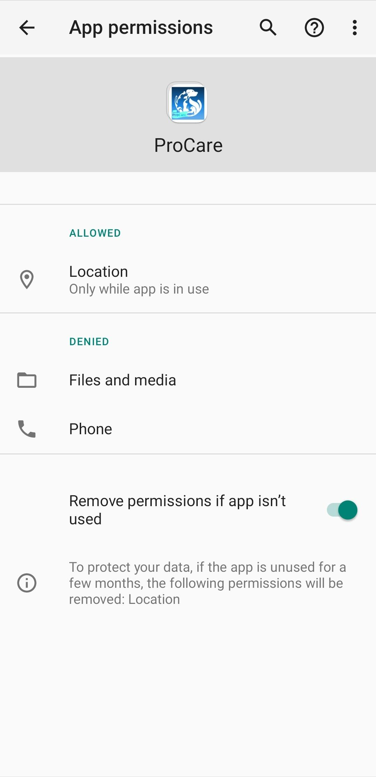


Introduction
Functionalities
Usability and versatility
Geolocation and map
Pet management
Interface customisation
Task notification
User-friendly search or access to information

Slide 4
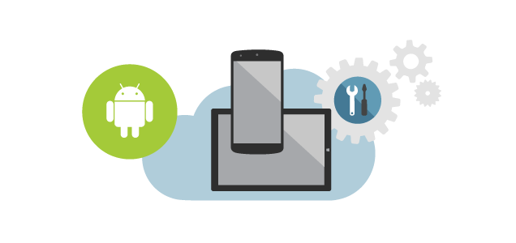

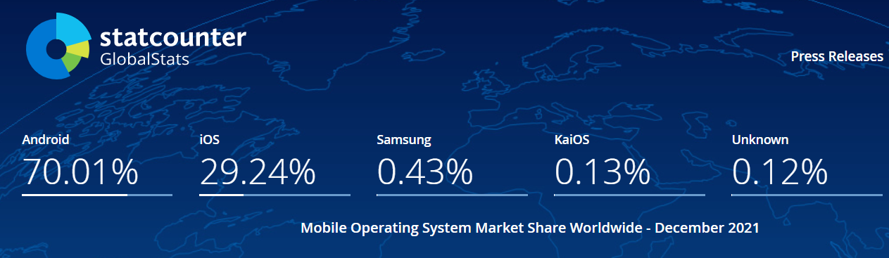


Slide 5
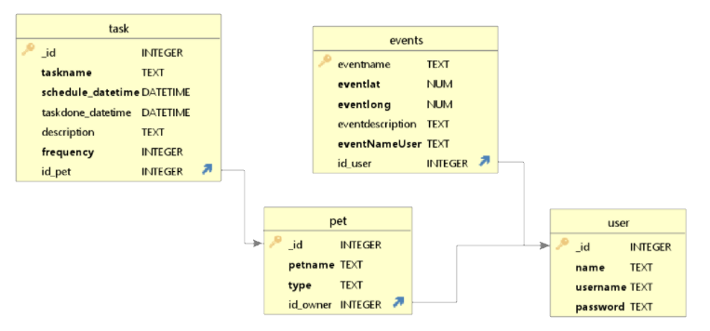
Database
Composition & Structure
4 Tables
Avoids redundant storage of data
No duplicate rows

Slide 6
Sections
Login/Register
Pet
Upcoming Tasks
Calendar
Settings
Profile user
6
1
5
2
4
3

Slide 7
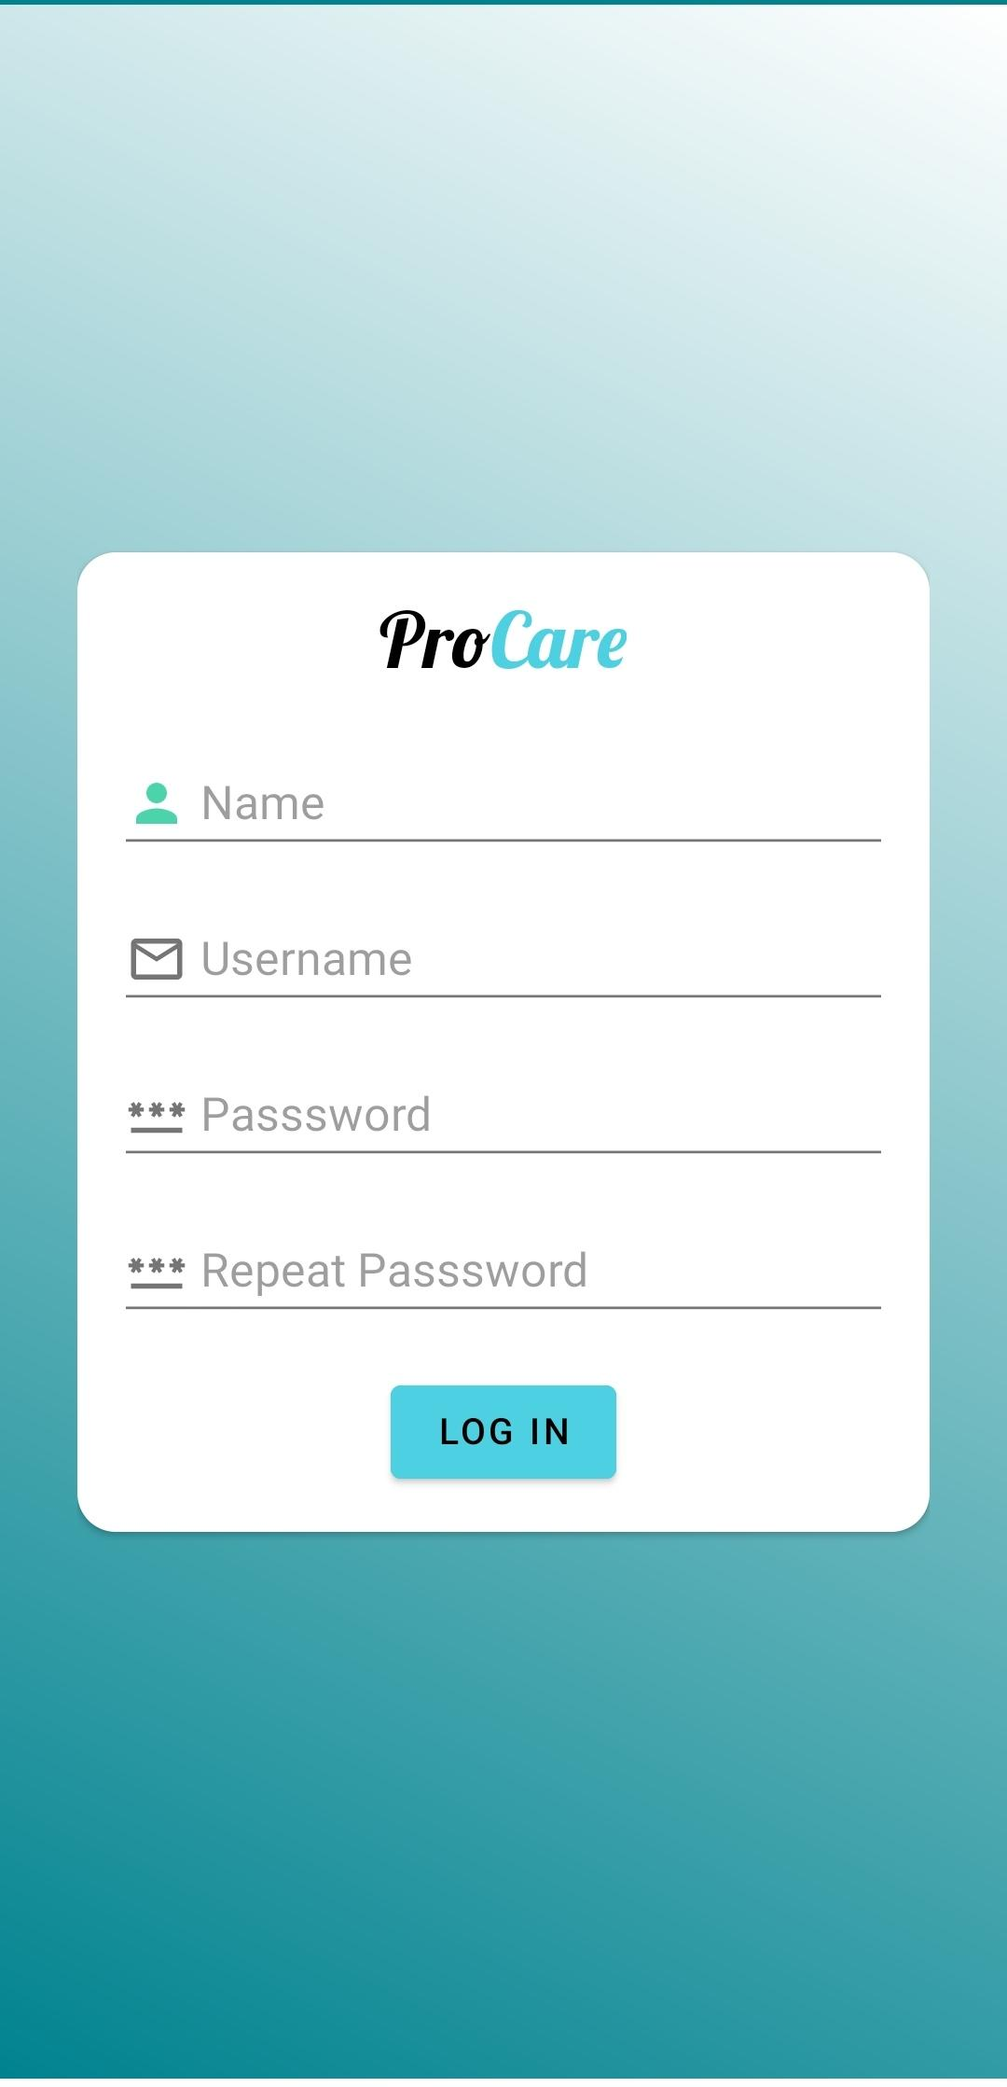
Login/Register section
Validate input values
Checks if username already exists

Slide 8
2. Pet section
Add pets
You can check the info of the animal
You can delete and modify the animal

Slide 9
3. Upcoming task section
The interfaz show all the task
You can add a task and select the day of the task
If you want, you can modify, delete and mark done the task the user selected

Slide 10

4. Calendar section
This interface sets a calendar
The days in blue color have a task
You can touch a day of the calendar an see the task below

Slide 11
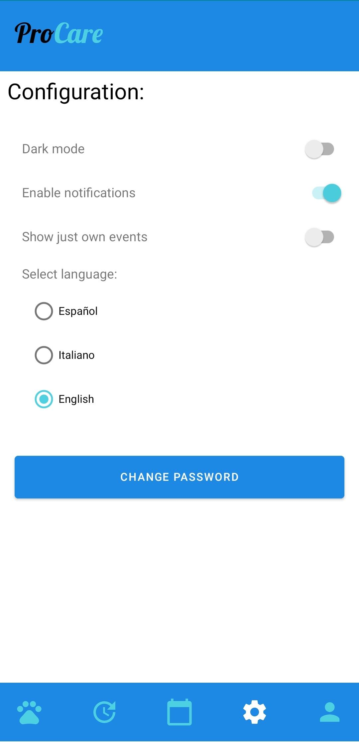
5. Settings section
Dark mode, Notifications enable and show just own events switches
Select the language what you prefer
You can change the password
If you want to change the password, you need to put the actual password and the new one twice.

Slide 12
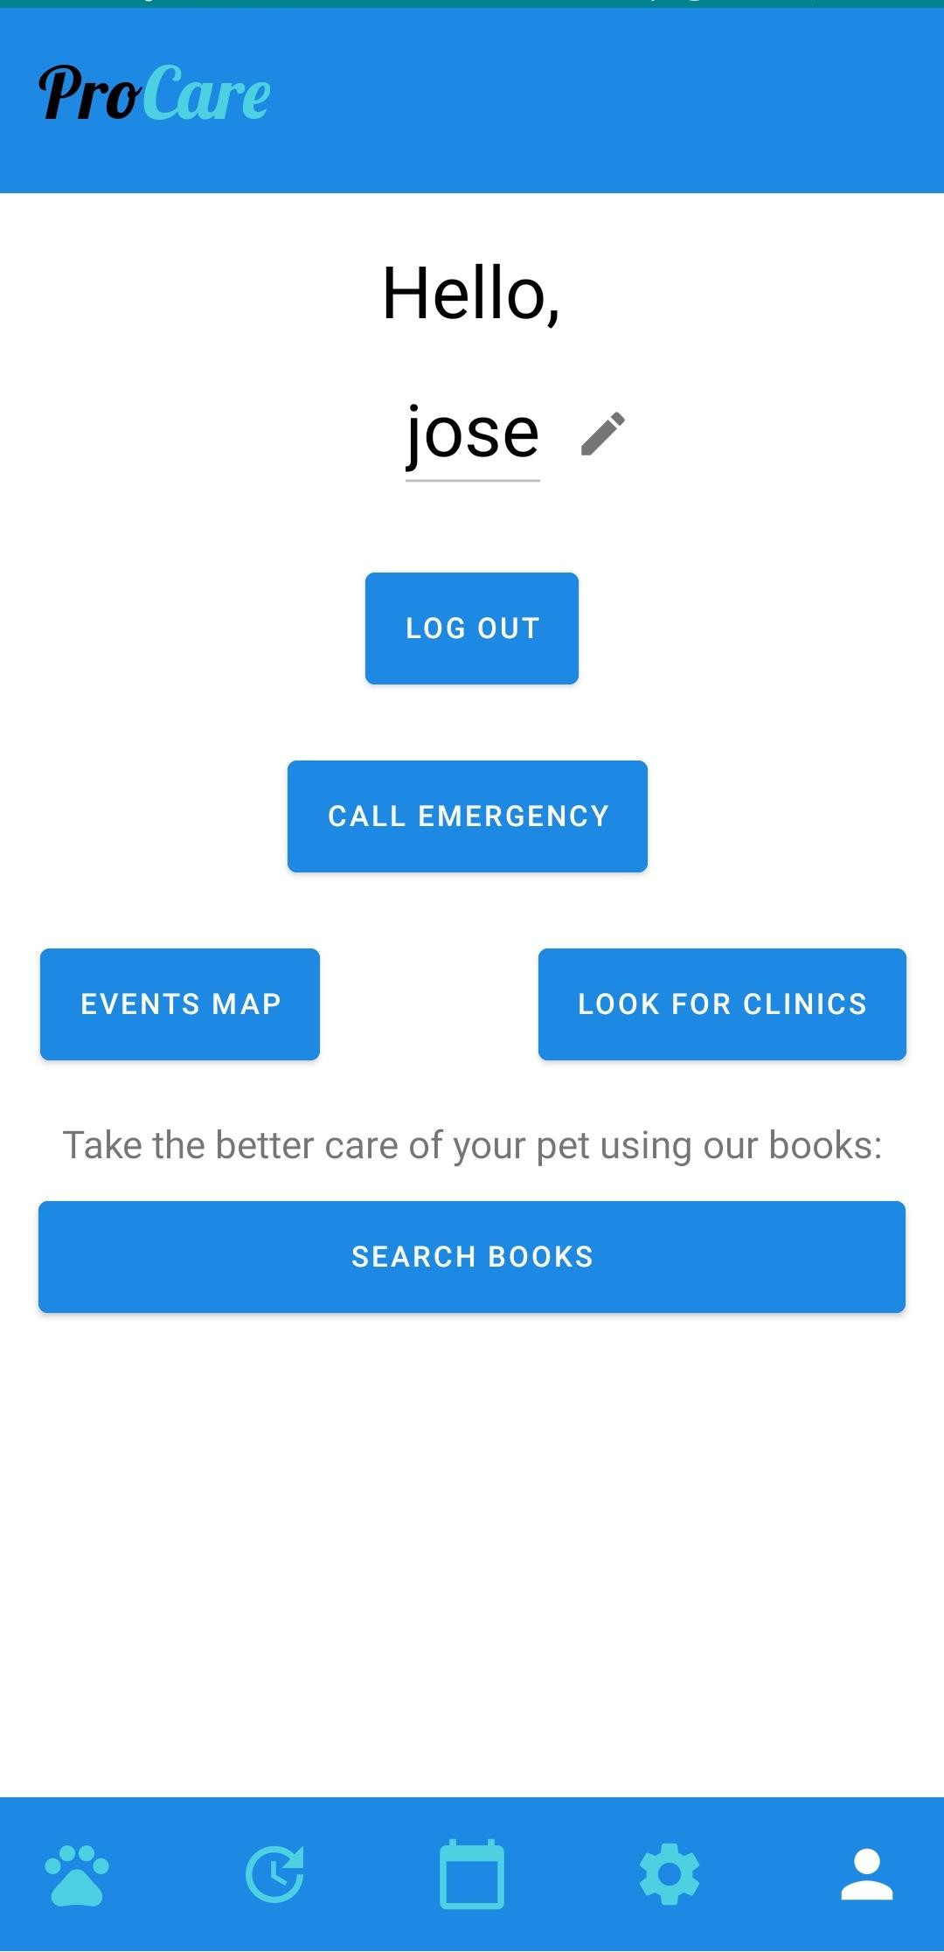
6. Profile user section
1
1
Change username
Call veterinary
emergency
2
2
4
3
Access Events Map functionality
3
4
Search clinics near the actual location
5
5
Search online books by introducing keywords

Slide 13
6. Profile user section
You can change the user name
Press the button Logout to change the user session.

Slide 14
6. Profile user section
If you press the button “Call Emergency” the app show you the mobile phone of a veterinary clinic from Milan.

Slide 15
6. Profile user section
Press the button Look for Clinic to see in google Maps all the Clinic close to you

Slide 16
6. Profile user section
The button Search book is to help the user to search for help books on the keywords they write in the search bar.

Slide 17
6. Profile user section
The event map have many functionalities, you can see in the map all the events of the users, if you want to see just your own events, go to settings and change the switch.
You can add a event in your current location
Select a mark in the map and see its info. If you are the creator of this event you can delete it

Slide 18
Thank you for your attention

